Slide 1
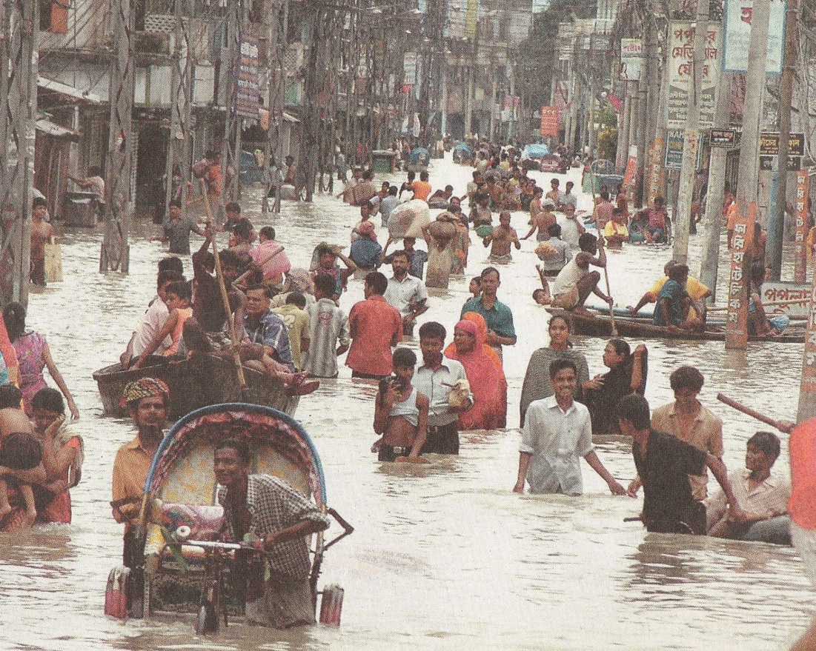

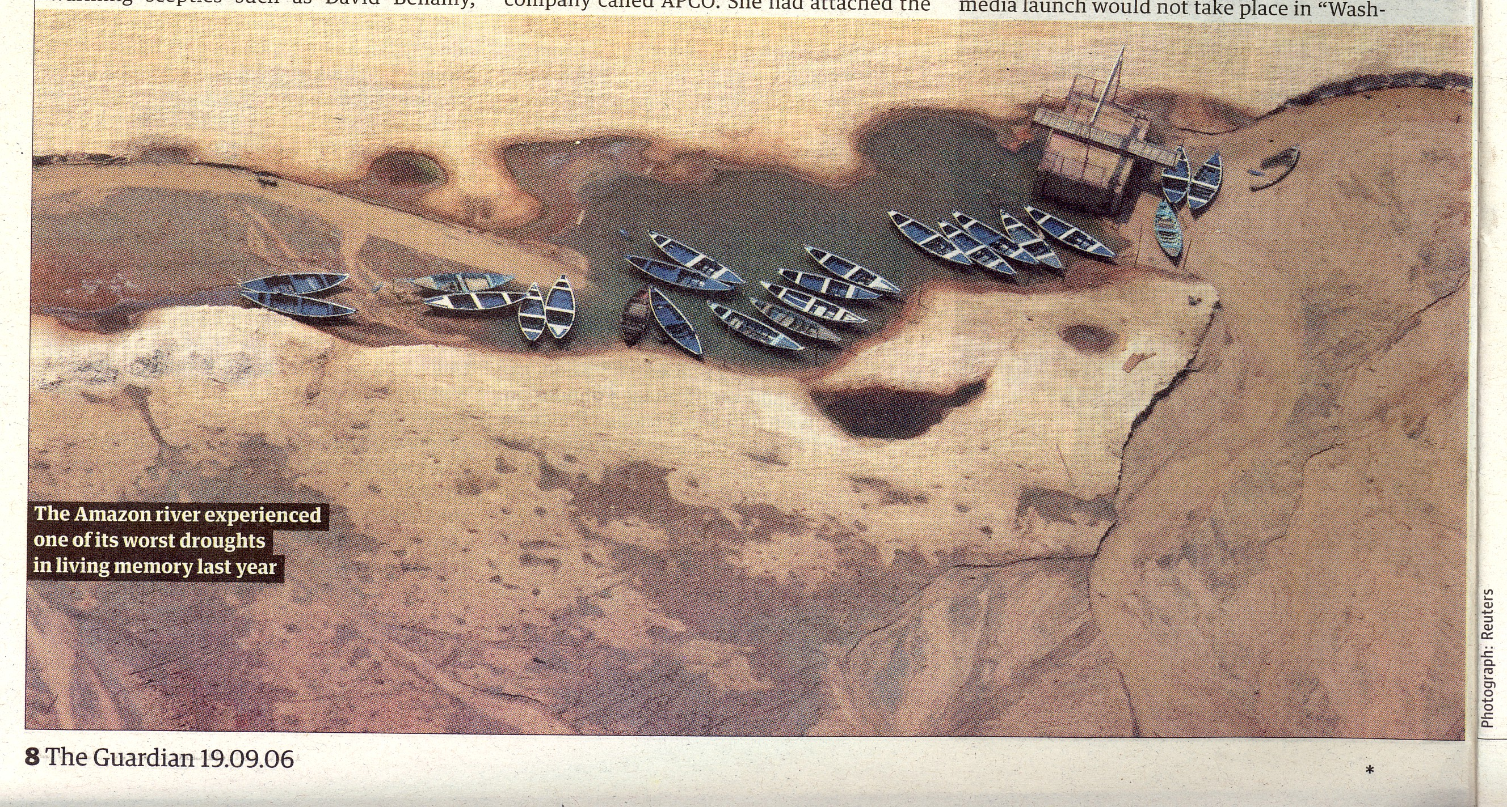
DRR workshop
WMO Commission for Hydrology
Geneva
10 -14 June 2013
Ann Calver

Slide 2
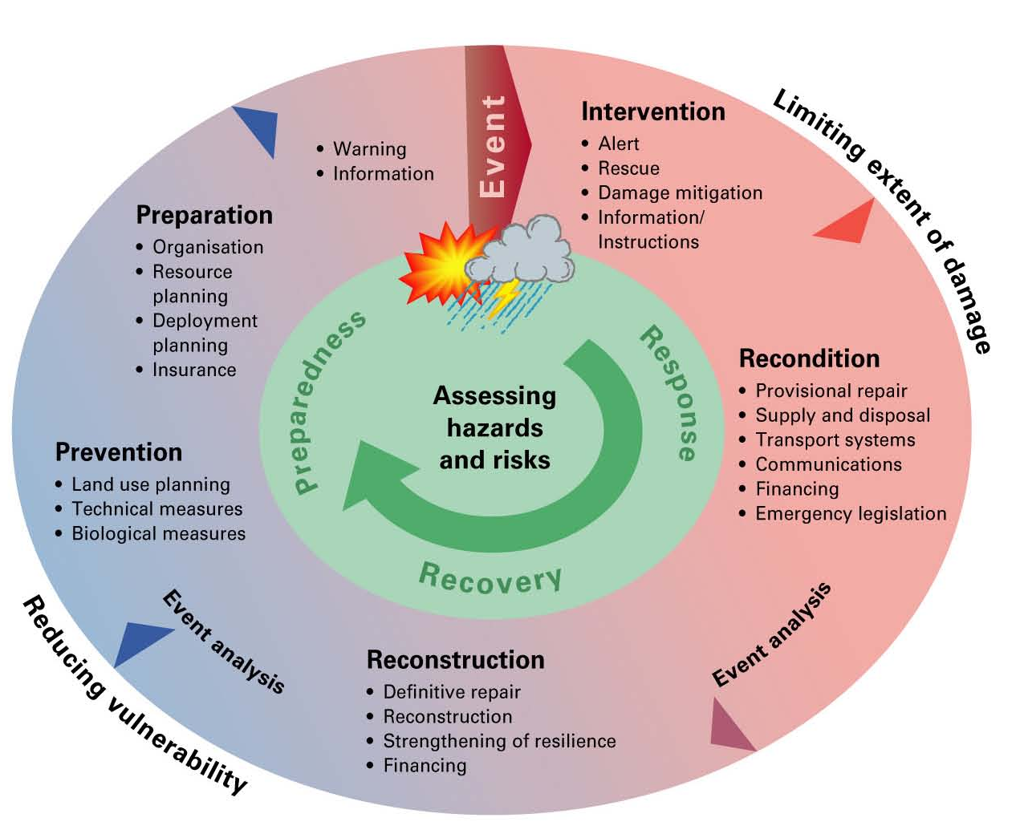
Hydrological setting
Hydrological extremes are plainly crucial – floods and droughts; and overall hydrological characterisation is also important in terms of background to other hazards
Risks are to health and safety, water and food supply, mobility, power and industrial functioning, environmental concerns
Hydrological disasters have both fast and slow run-in times, and recovery times vary; sequences of events can be important
source: Swiss Federal Office for Civil Protection

Slide 3
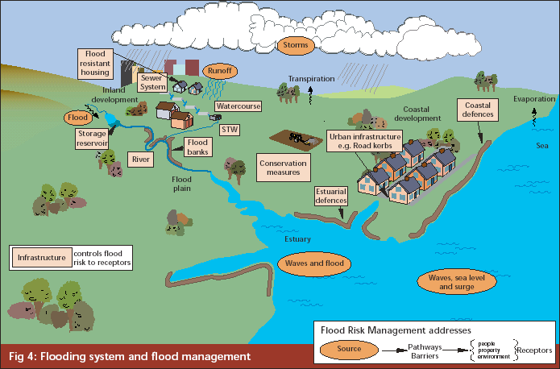
Hydrological setting
- continued
Hydrological domain is one where intervention is possible to a degree; it has the challenge of being a multi-use and time-varying domain
Better strategic planning is likely to reduce operational time-of-disaster stress
Risk management in hydrology is often less dependent on other regions/nations than in the case of atmospheric risks: this has an impact on the degree of need for standardisation of data/approach
groundwater
source: M Bramley

Slide 4
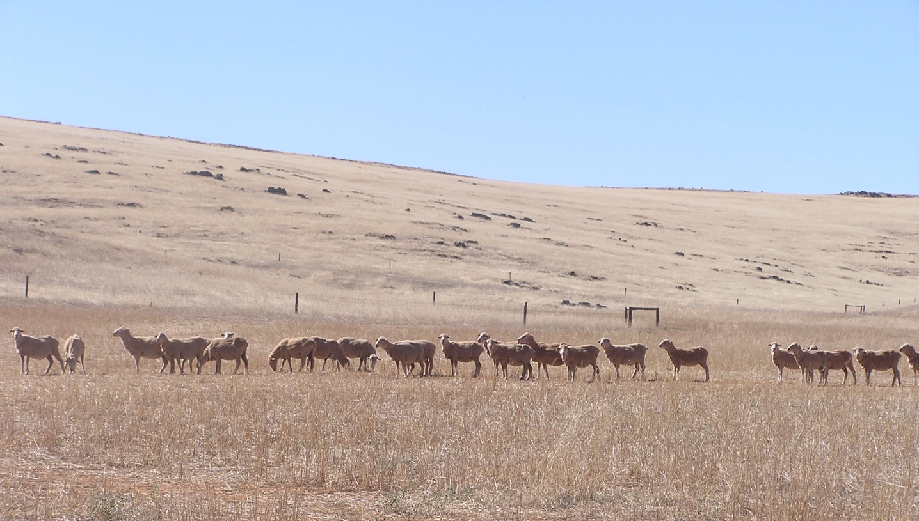
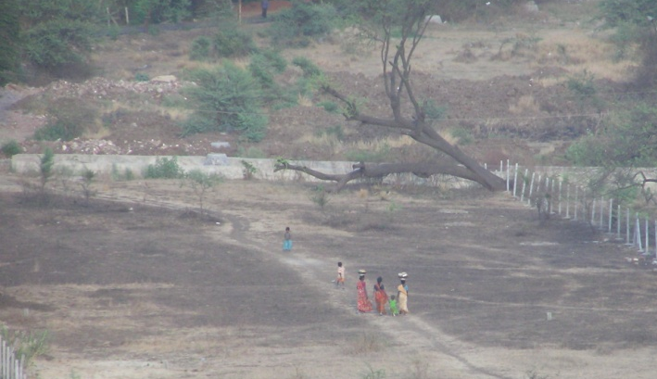
Key drought risk activities
Monitoring development of conditions
Analysing drought severity / drought frequency estimation / development of drought indices
Prediction of droughts

Slide 5
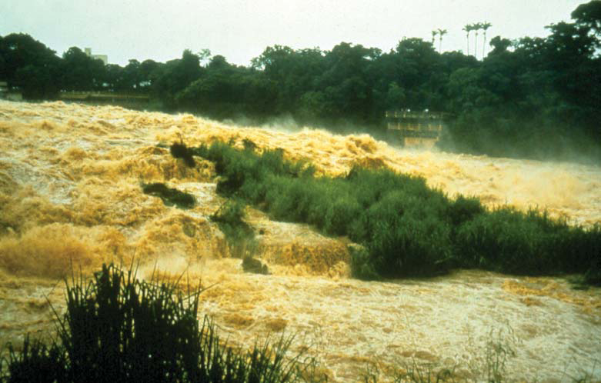
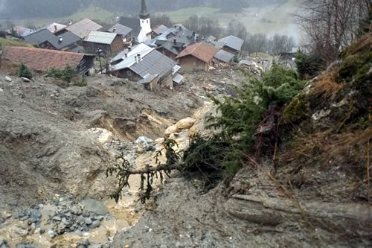
Key flood risk activities
Short-term flood forecasting
Longer term flood frequency estimation
Inundation extent
Specific aspects eg. urban flooding,
groundwater floods

Slide 6
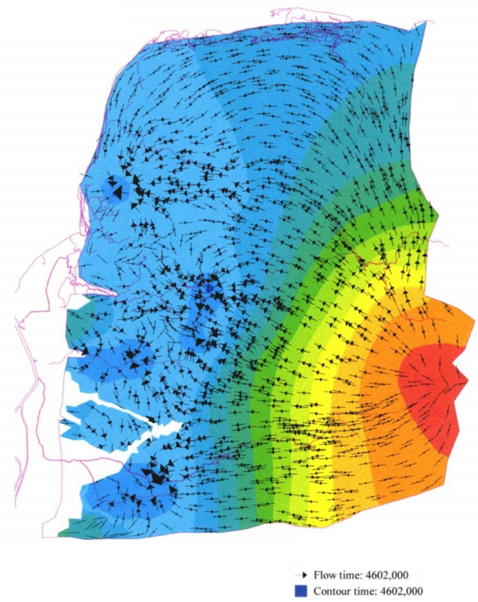
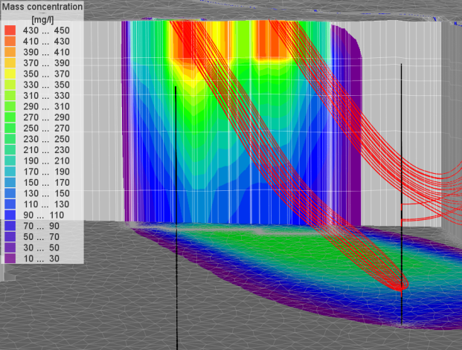
Further hydrological involvement
Heavy snow
Tropical cyclone
Coastal flooding
Landslide / mudslide
Rapid melting of glaciers
Waterborne hazards – characterisation of hydrology and hydrogeology
groundwater flow paths
potential contaminant pathways
source: VLWRC

Slide 7
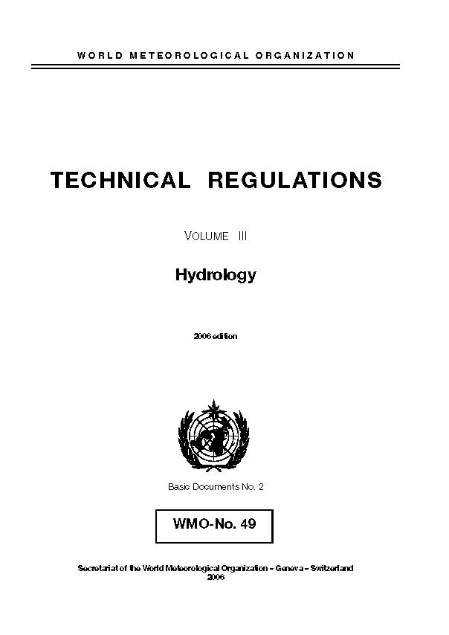
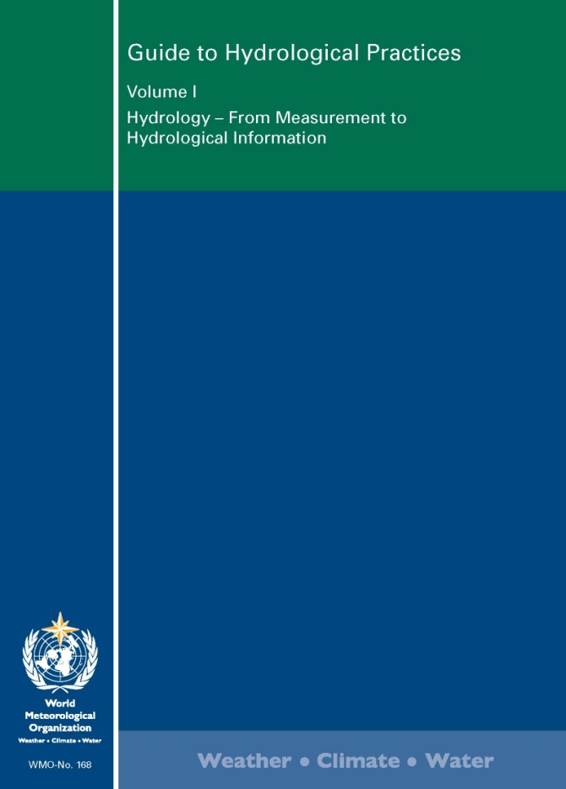
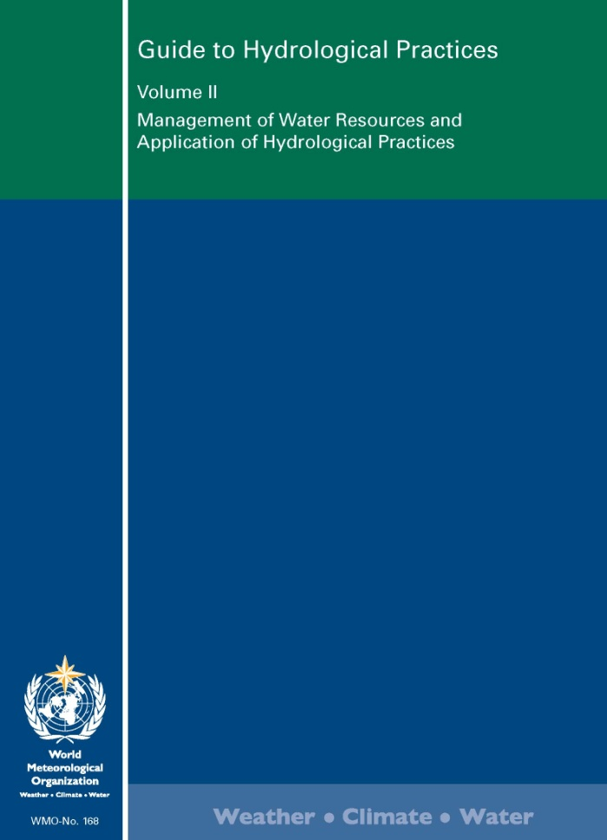
Commission for Hydrology documents
Technical Regulations, volume III: Hydrology 2006
Manuals (see next slide)
[ International Glossary of Hydrology – with UNESCO ]
Guidelines / guidance material
especially the Guide to
Hydrological Practices 2008
Technical documents
(see next but one slide)

Slide 8
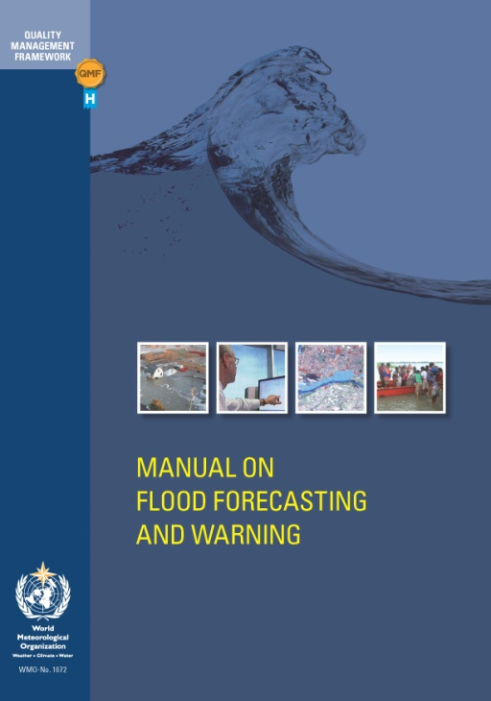
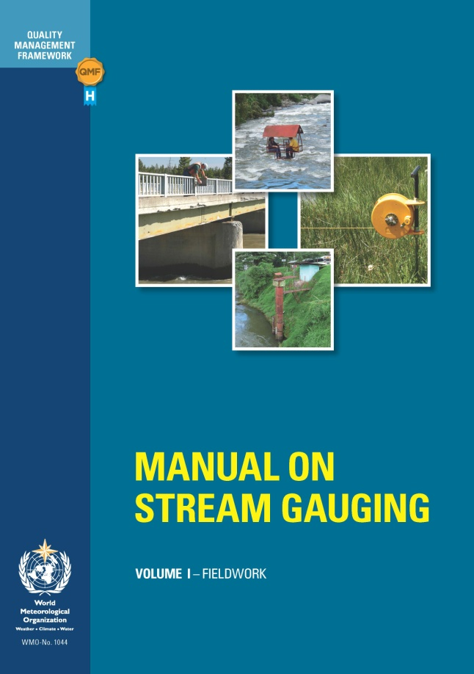
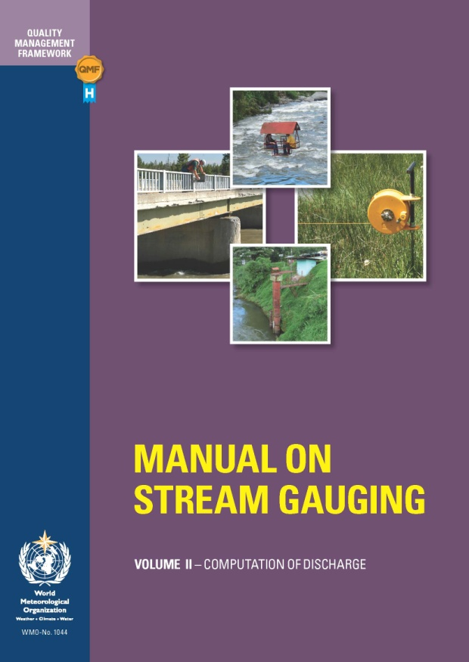
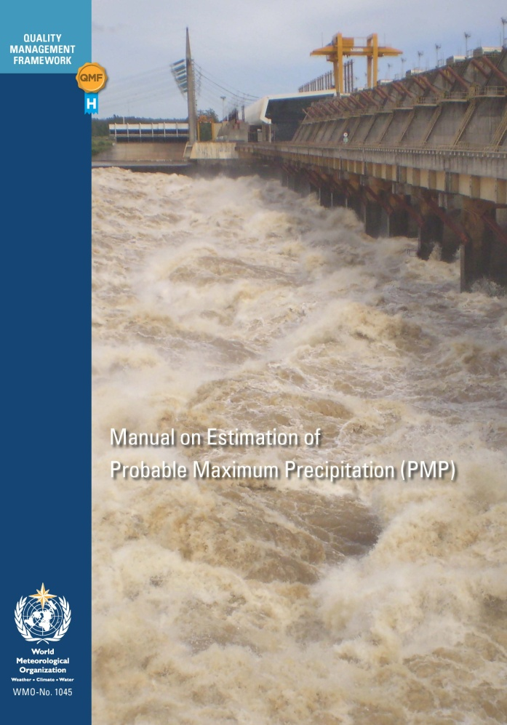
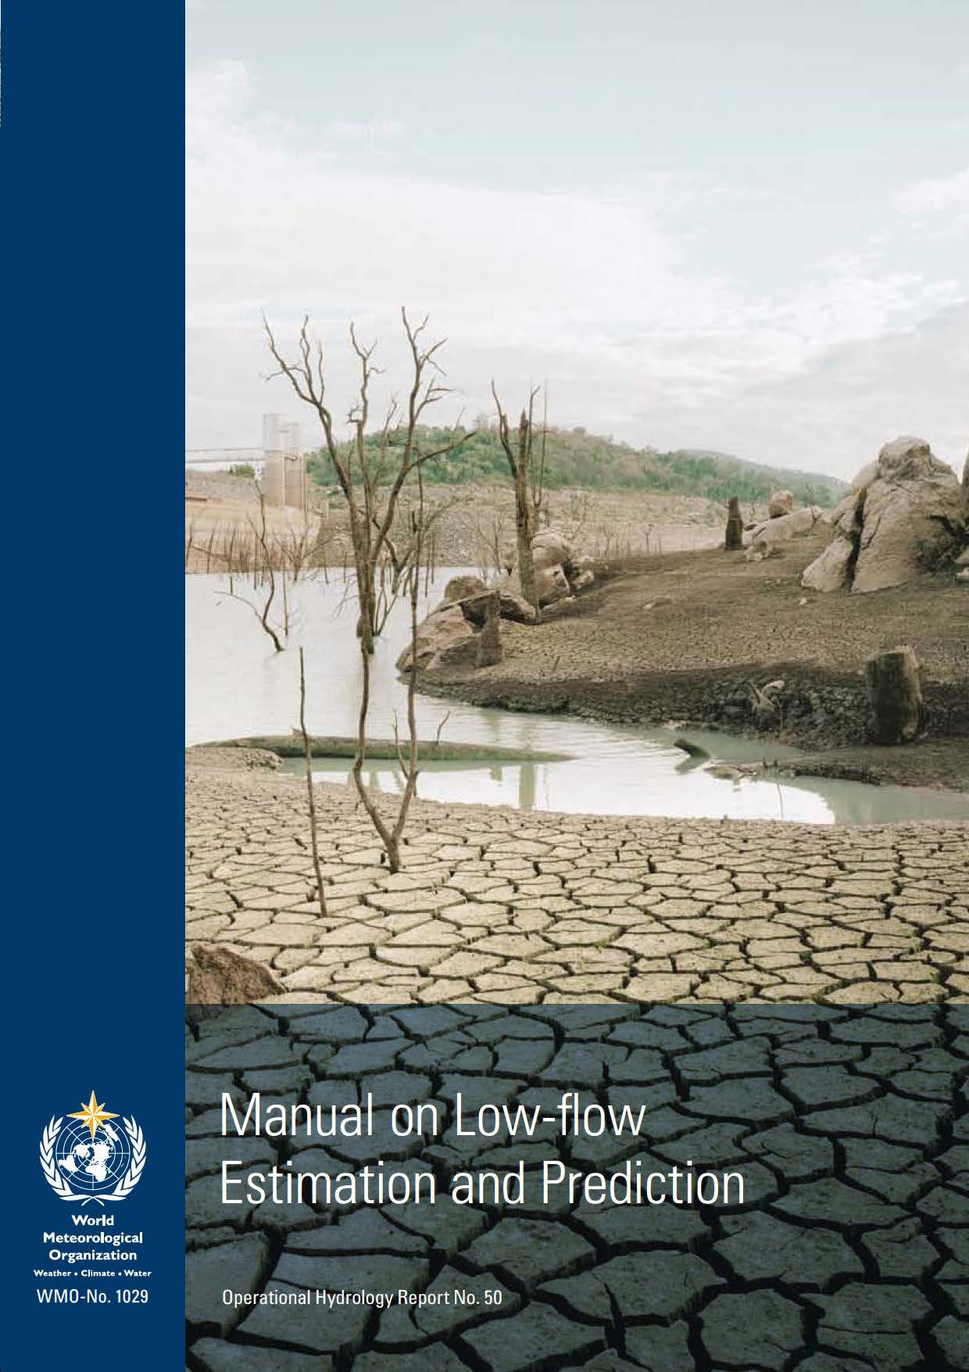
Commission for Hydrology documents - continued

Slide 9
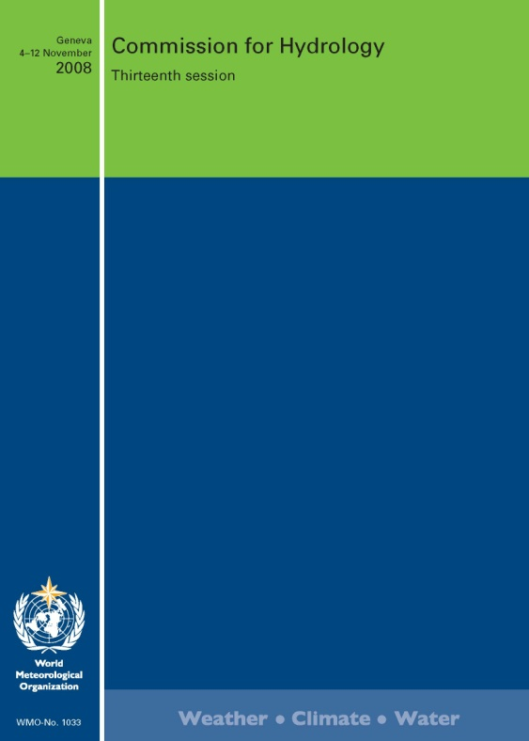
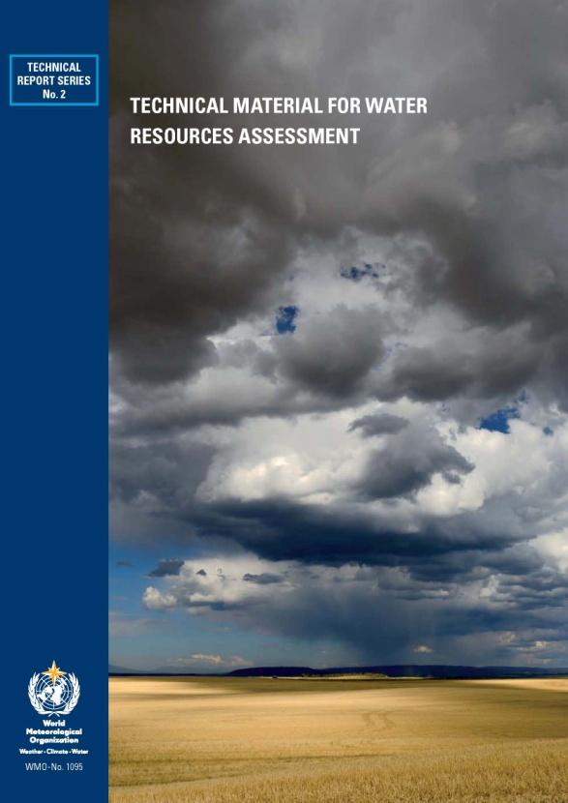
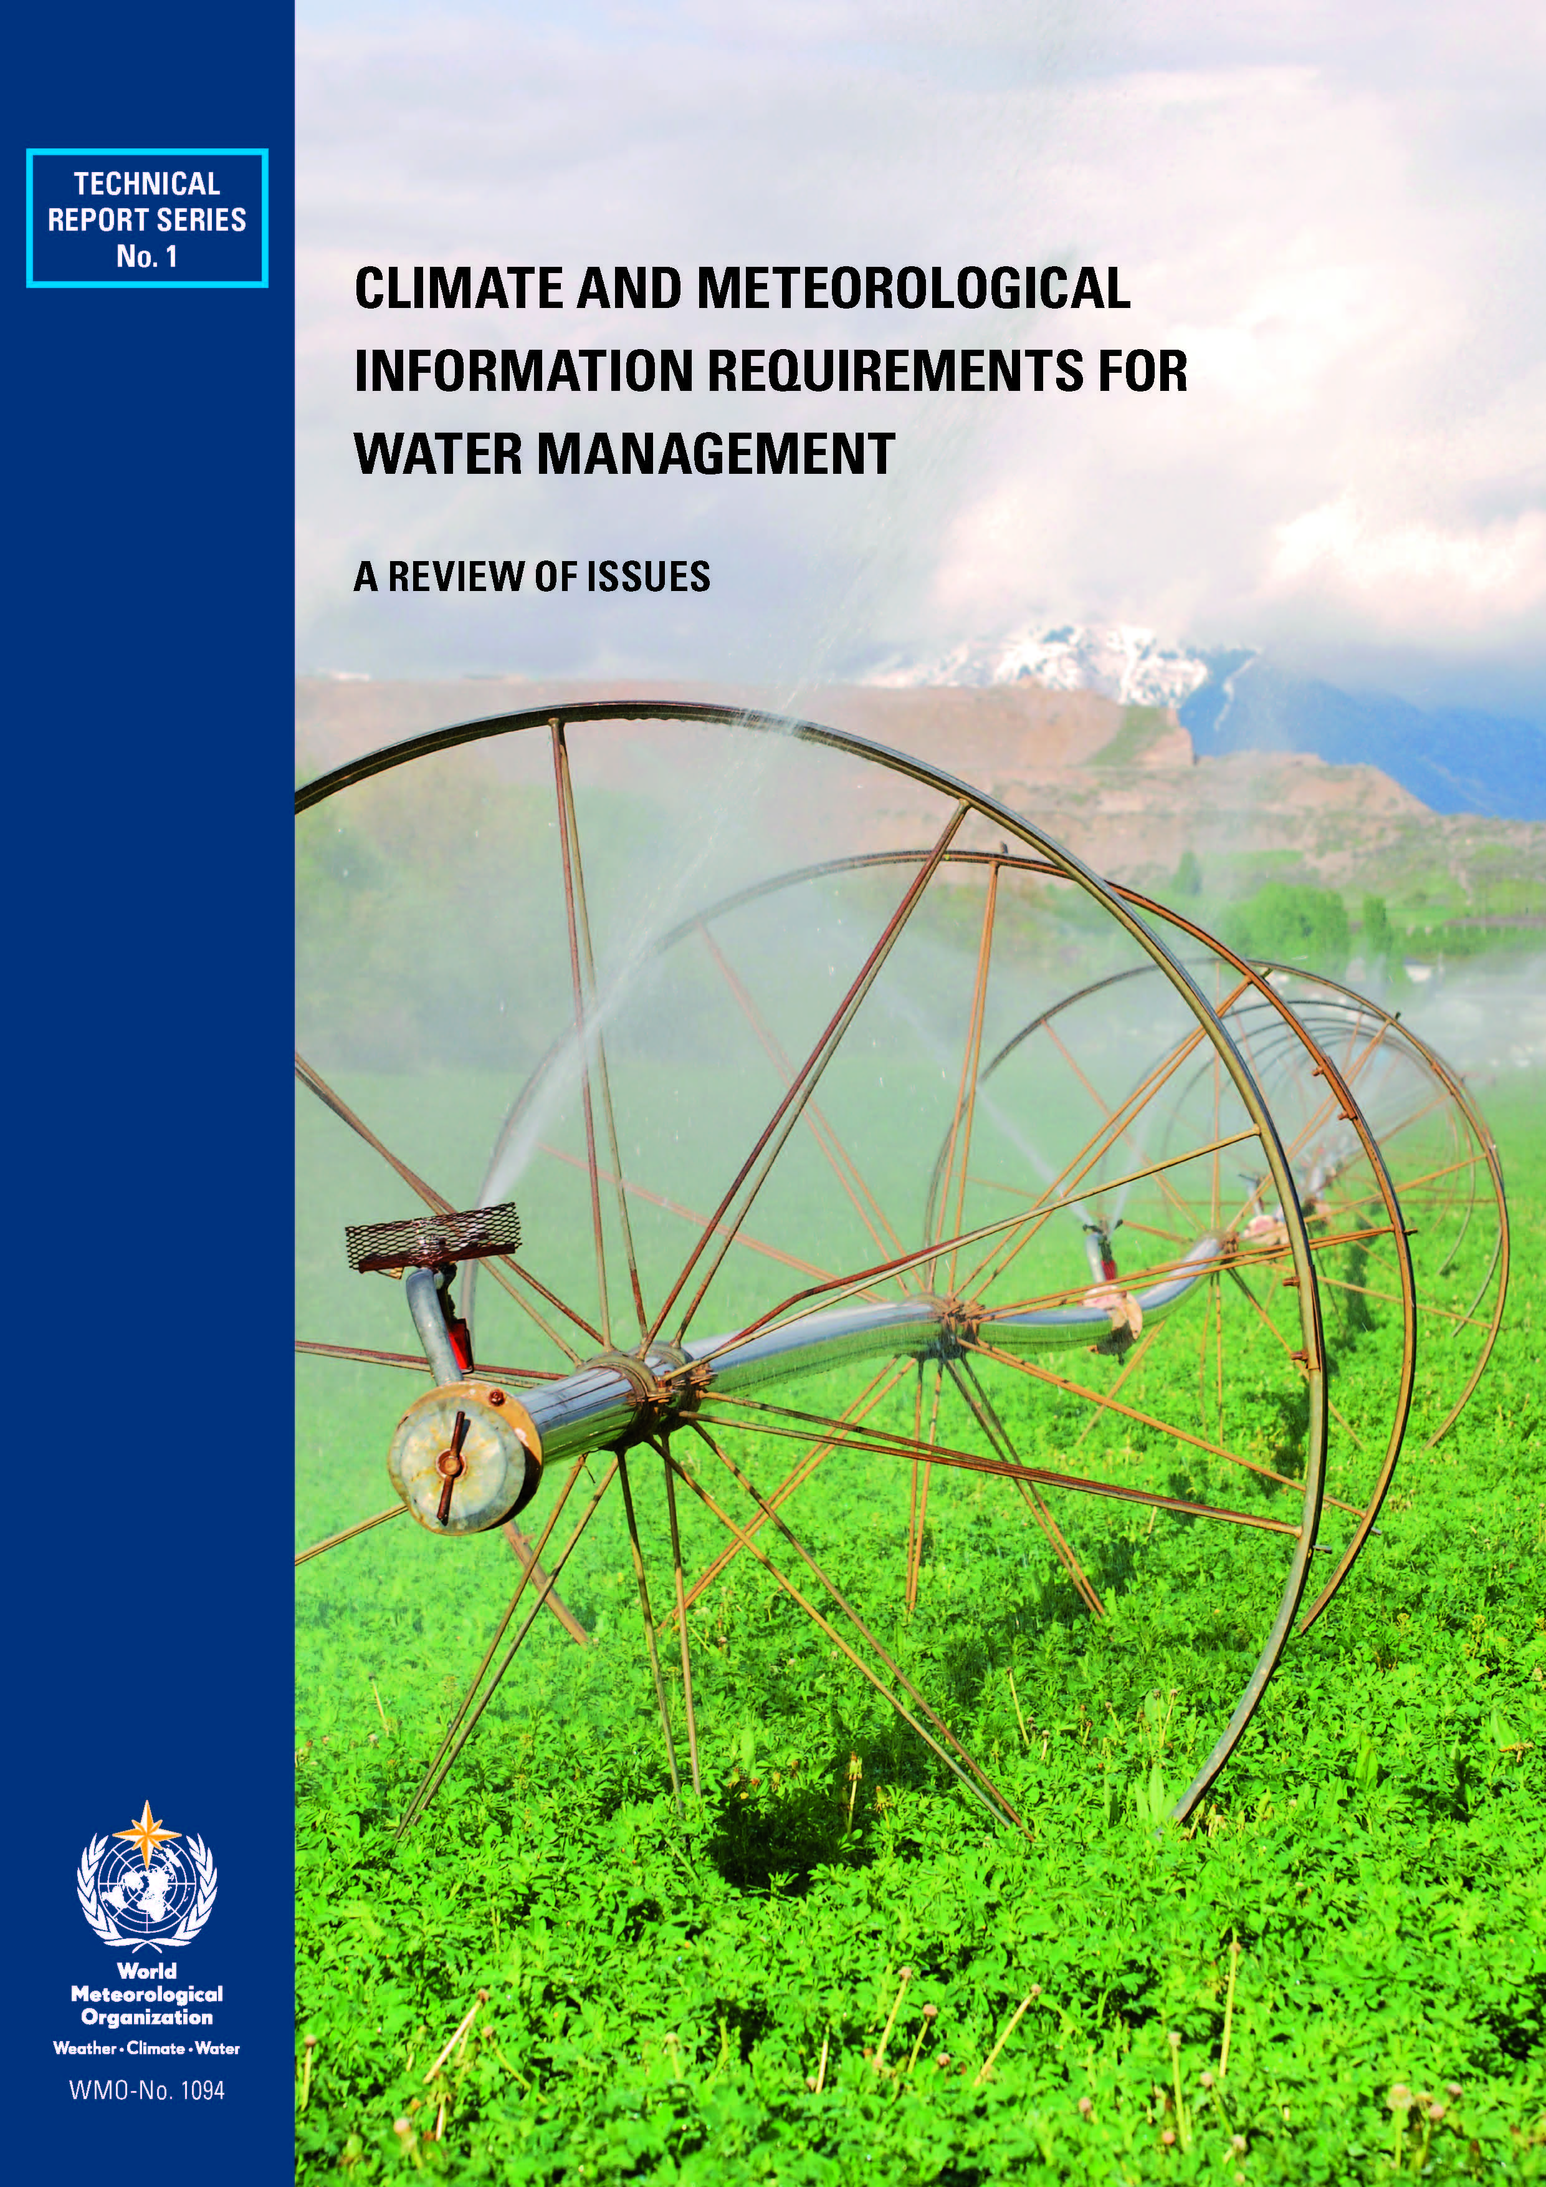
Commission for Hydrology documents - continued
Various technical reports
Various reports from operational hydrology series
CHy XIII Annex 1 to resolution 1: A quality management framework in hydrology
Technical material for water resources assessment
Climate and information requirements for water management

Slide 10
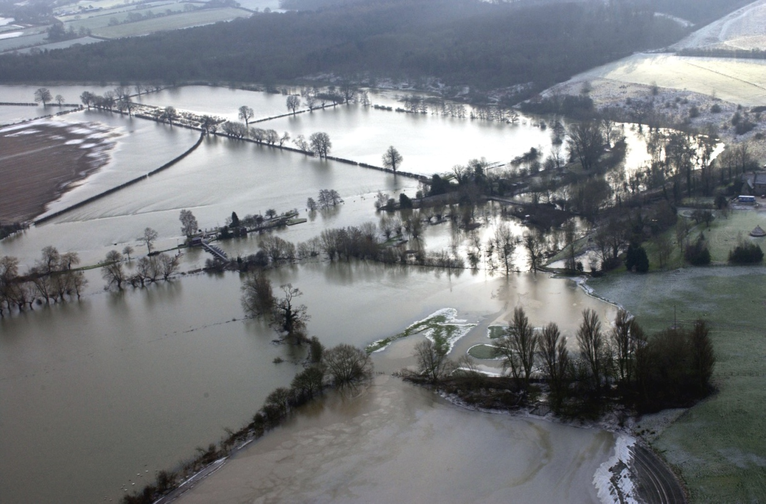
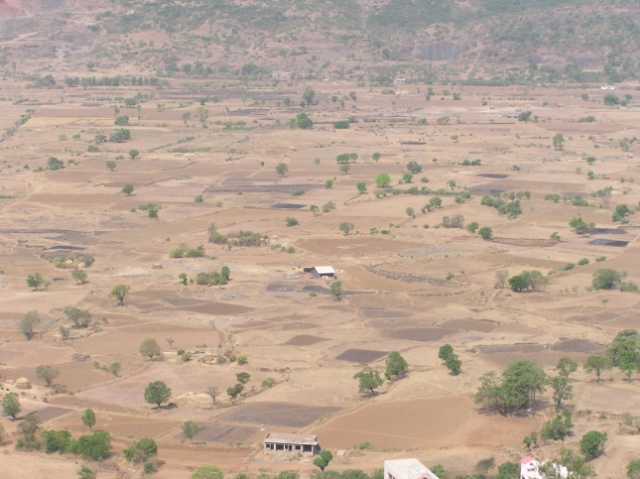
A few short examples of how in practice hydrology assesses disaster risk
and the data and techniques involved ... ...
© RAF Benson

Slide 11
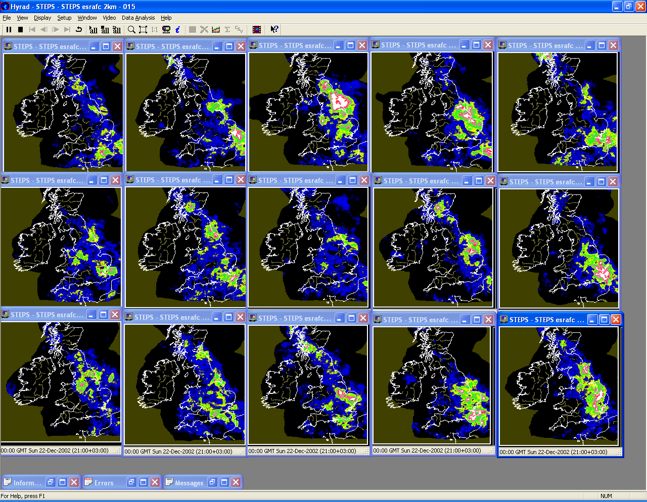
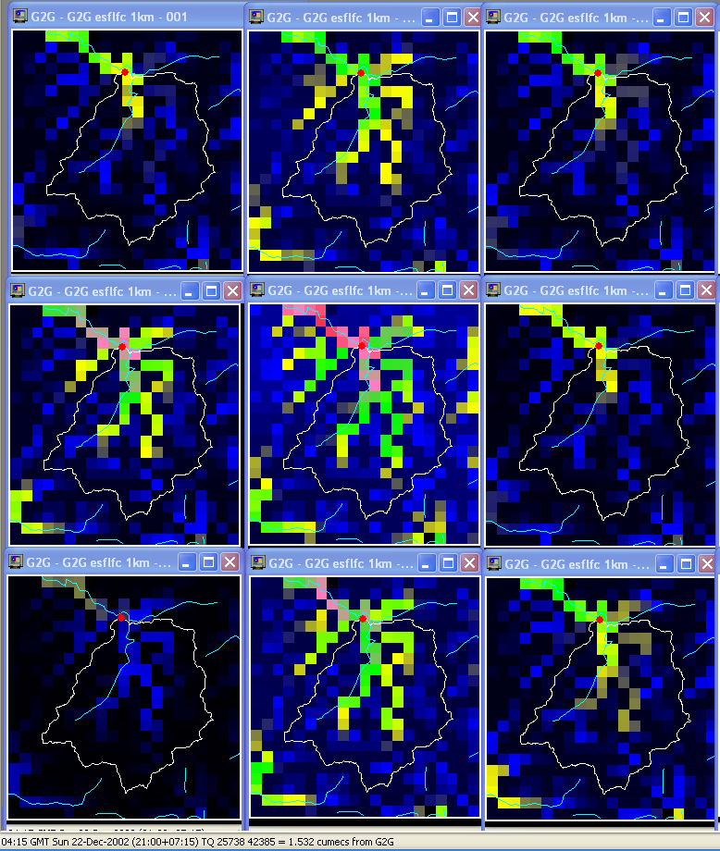
Real-time river flood ensemble forecasting
precipitation
river flows
based on precipitation forecasts and data,
with catchment hydrological modelling
calibrated on past river flow data record
source: UK Met Office & NERC

Slide 12
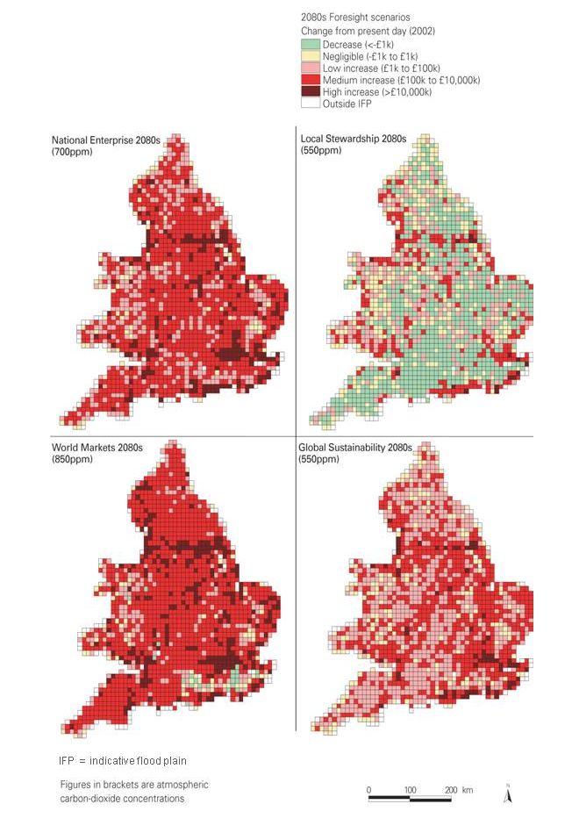
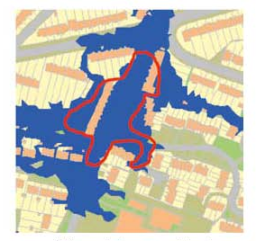
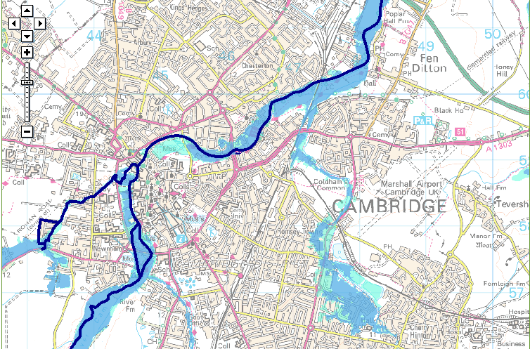
Flood inundation extents
based on long river flow records, statistical analyses, hydraulic modelling and (right) socioeconomic scenarios and land use data
sources: Environment Agency England & Wales;
UK Department of Trade and Industry

Slide 13
Projecting river flow for drought development awareness
based on river flow records, catchment precipitation,
catchment hydrological modelling calibrated on past records
source: Environment Agency, England

Slide 14
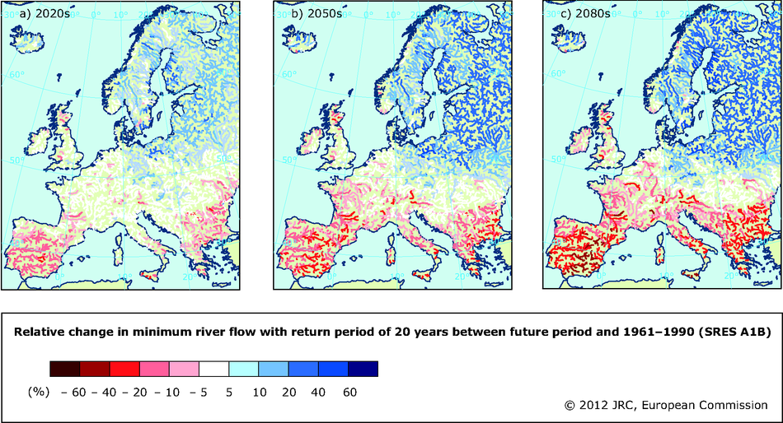
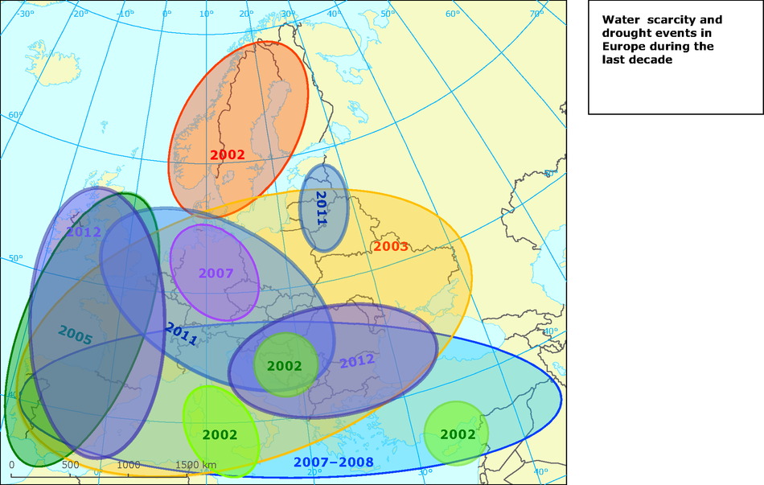
Long-term drought frequencies
Relative change in minimum river flow with return period of 20 years
compared with 1961-1990
recent
drought extents
based on climate projections, catchment data and hydrological modelling, statistical analyses
source: European Environment Agency

Slide 15
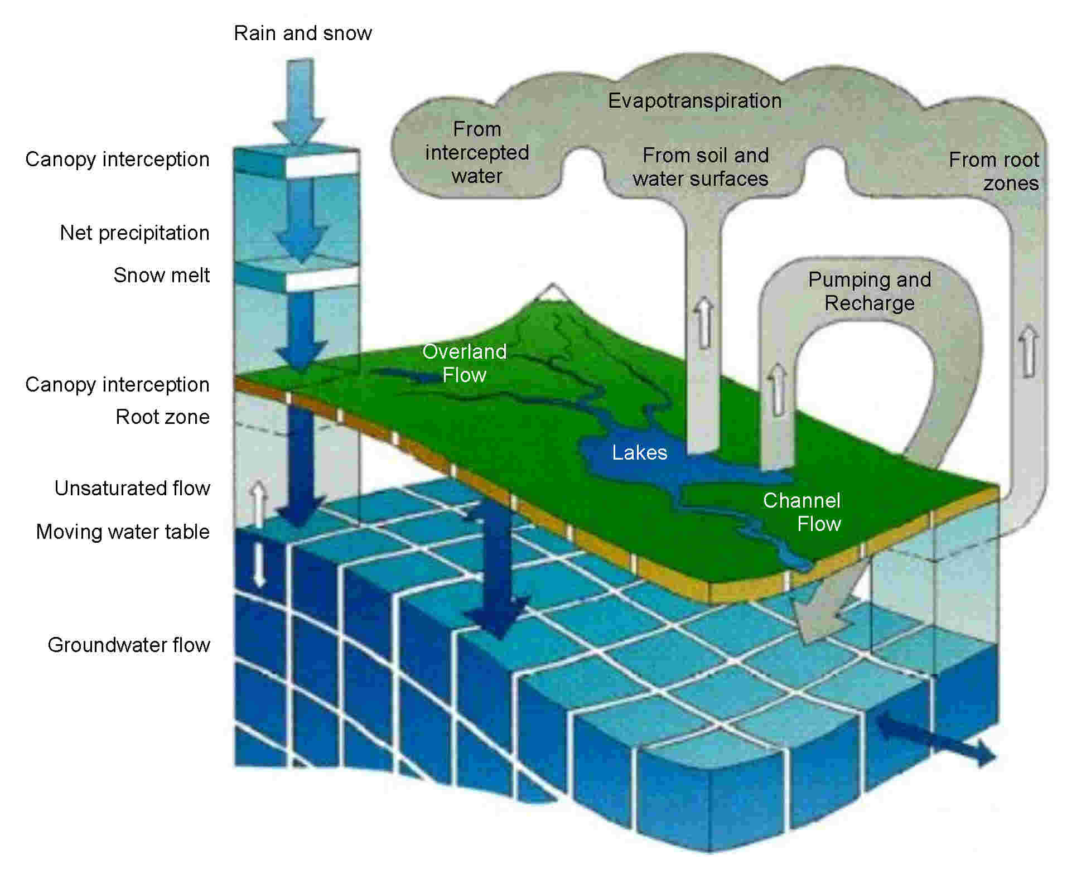
Some key cross-cutting issues
Hydrological modelling
Data-sparse areas
Uncertainty / robustness
/ error evaluation
Quality management
Non-stationarity
Information transfer
source: DHI

Slide 16
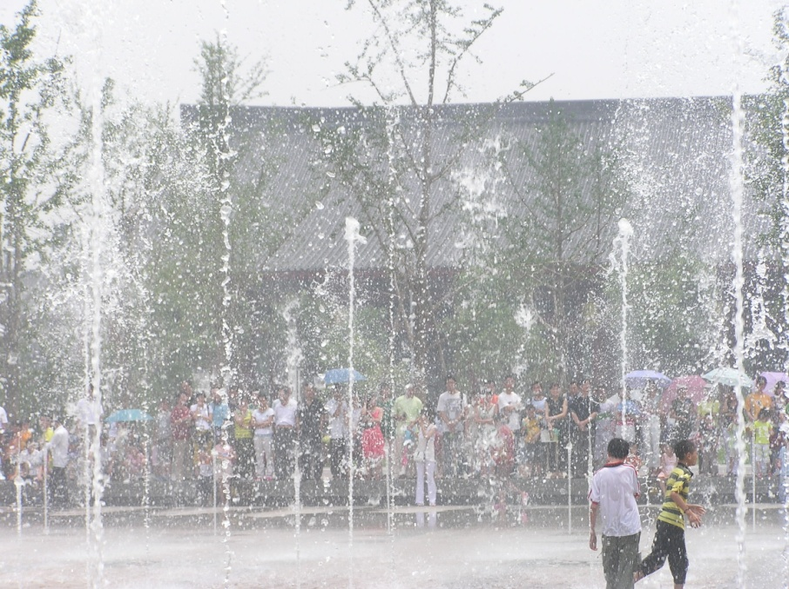
CONCLUDING REMARKS
Level to which hydrological risks are currently managed varies greatly world-wide and with the specific risk – this is
in part a function of assessment abilities
Both standard and non-standard data and methods are used in hydrological risk assessment; suites of hydrological standards may be more appropriate than single standards
Realistic aim: world-wide awareness by practitioners
of the range of available hydrological techniques and,
at a different level, by those needing to use hydrological information to reduce disaster risk
further information: anncalver@lwrc.co.uk

